Slide 1


Nervous System Anatomy
Dr. Mahdi H. Hammadi
PhD Sc. Clinical Physiology

Slide 2
Nervous System Anatomy
Nervous Tissue
The majority of the nervous system is tissue made up of two classes of cells: neurons and neuroglia.

Slide 3
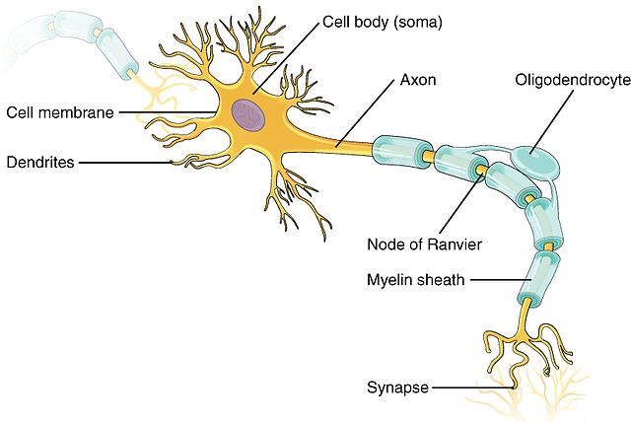
Neurons:

Slide 4
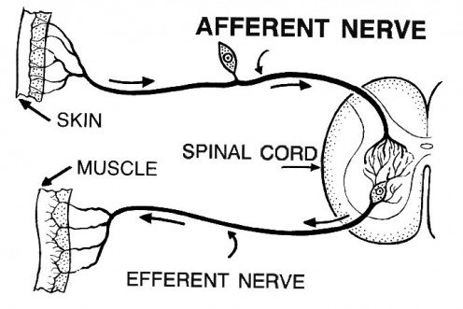
There are 3 basic classes of neurons:
Afferent neurons
Efferent neurons
Interneurons

Slide 5
Neuroglia:
Function:
that protect
feed
insulate the neuron
Maintaining a functional nervous system.

Slide 6
Nervous System Composed :
Central nervous system
Peripheral nervous system

Slide 7
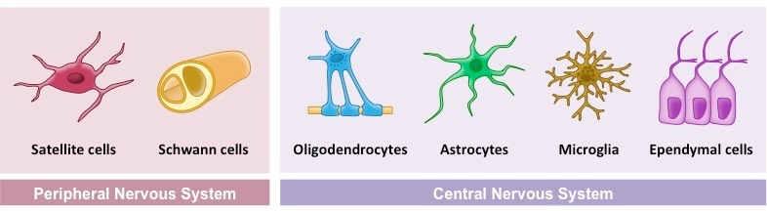
Types of glia cell in nervous system

Slide 8
Brain
The brain, a soft, wrinkled organ that weighs about 3 pounds, is located inside the cranial cavity, where the bones of the skull surround and protect it. The approximately 100 billion neurons of the brain form the main control center of the body.

Slide 9
The central nervous system (CNS) composed from:
The Brain
The Spinal Cord

Slide 10
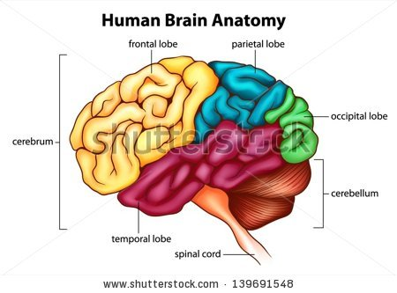

Slide 11
The 3 major components of the brain:
the cerebrum
cerebellum
brain stem

Slide 12
The cerebrum is divided into left and right hemispheres, each composed of:
Frontal lobe
Temporal lobe
Parietal lobe
occipital lobe
cerebral cortex (gray matter): is the outside portion of the cerebrum

Slide 13
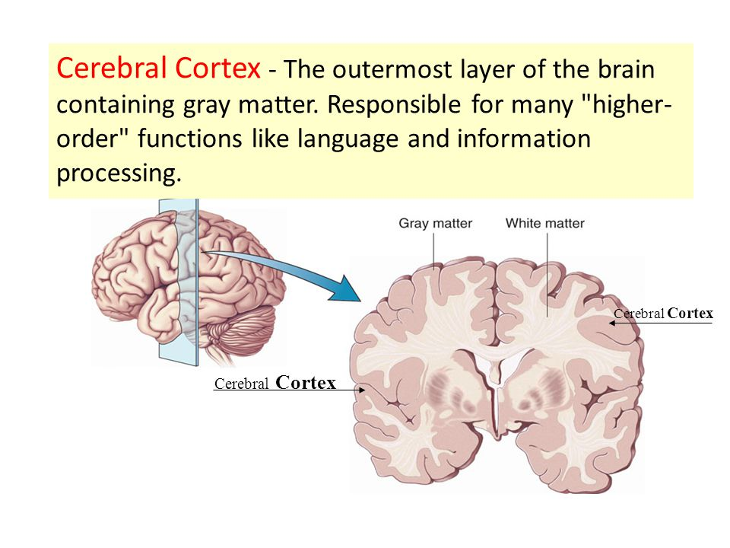

Slide 14
The brain stem
Connects the brain with the spinal cord
Composed of 3 structures:
the midbrain
pons
medulla oblongata

Slide 15
The brain stem
Connects the brain with the spinal cord
Composed of 3 structures:
the midbrain
pons
medulla oblongata
Function:
The brain stem provides us with automatic functions that are necessary for survival.

Slide 16
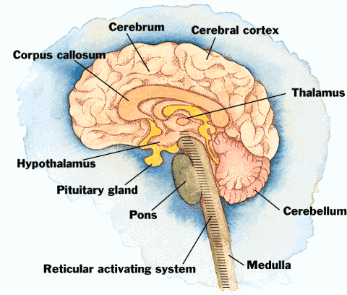

Slide 17
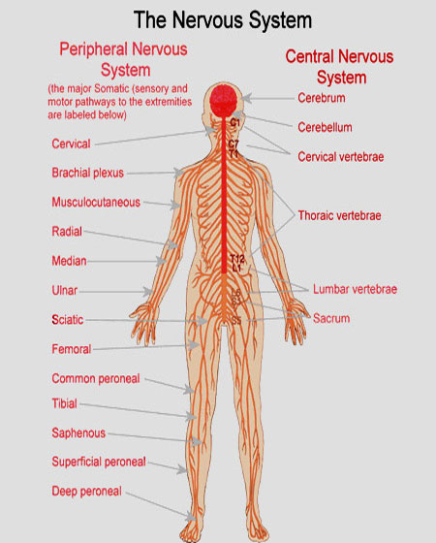

Slide 18
Spinal Cord
The spinal cord is a long, thin mass of bundled neurons that carries information through the vertebral cavity of the spine beginning at the medulla oblongata of the brain on its superior end and continuing inferiorly to the lumbar region of the spine.

Slide 19
Function the white matter of the spinal cord:
The main conduit of nerve signals to the body from the brain.
Function the grey matter of the spinal cord:
Integrates reflexes to stimuli

Slide 20
Nerves
Nerves are bundles of axons in the peripheral nervous system (PNS) that act as information highways to carry signals between the brain and spinal cord and the rest of the body. Each axon is wrapped in a connective tissue sheath called the endoneurium. The wrapping of nerves with connective tissue helps to protect the axons and to increase the speed of their communication within the body.

Slide 21
Cranial Nerves.
Extending from the inferior side of the brain are 12 pairs of cranial nerves.

Slide 22
Meninges
The meninges are the protective coverings of the central nervous system (CNS).
They consist of three layers:
Dura mater. The dura mater, which means “tough mother,” most superficial layer of meninges. Made of dense irregular connective tissue, it Dura mater protects the CNS from external damage
Arachnoid mater. The arachnoid mater, which means “spider-like mother,” is much thinner and more delicate than the dura mater.
Pia mater. The pia mater, which means “tender mother,” is a thin and delicate layer of tissue that rests on the outside of the brain and spinal cord.

Slide 23
Cerebrospinal Fluid
The space surrounding the organs of the CNS is filled with a clear fluid known as cerebrospinal fluid (CSF). CSF is formed from blood plasma by special structures called choroid plexuses. The choroid plexuses contain many capillaries lined with epithelial tissue that filters blood plasma and allows the filtered fluid to enter the space around the brain.

